Slide 1
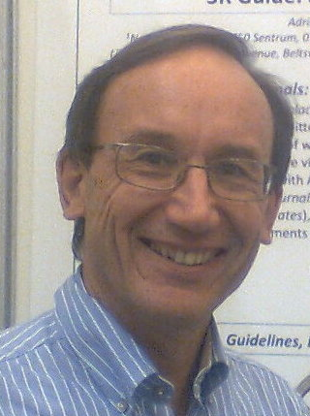


Building bridges between the world of traditional lab animal science and environmental research: better science and improved animal welfare
norecopa.no/SETAC
Adrian Smith
adrian.smith@norecopa.no
https://norecopa.no

Slide 2
Norecopa
Norway's National Consensus Platform for the
Three Rs: Replacement, Reduction and Refinement
and a source of global 3R resources
https://norecopa.no
Norecopa: PREPARE for better Science

Slide 3

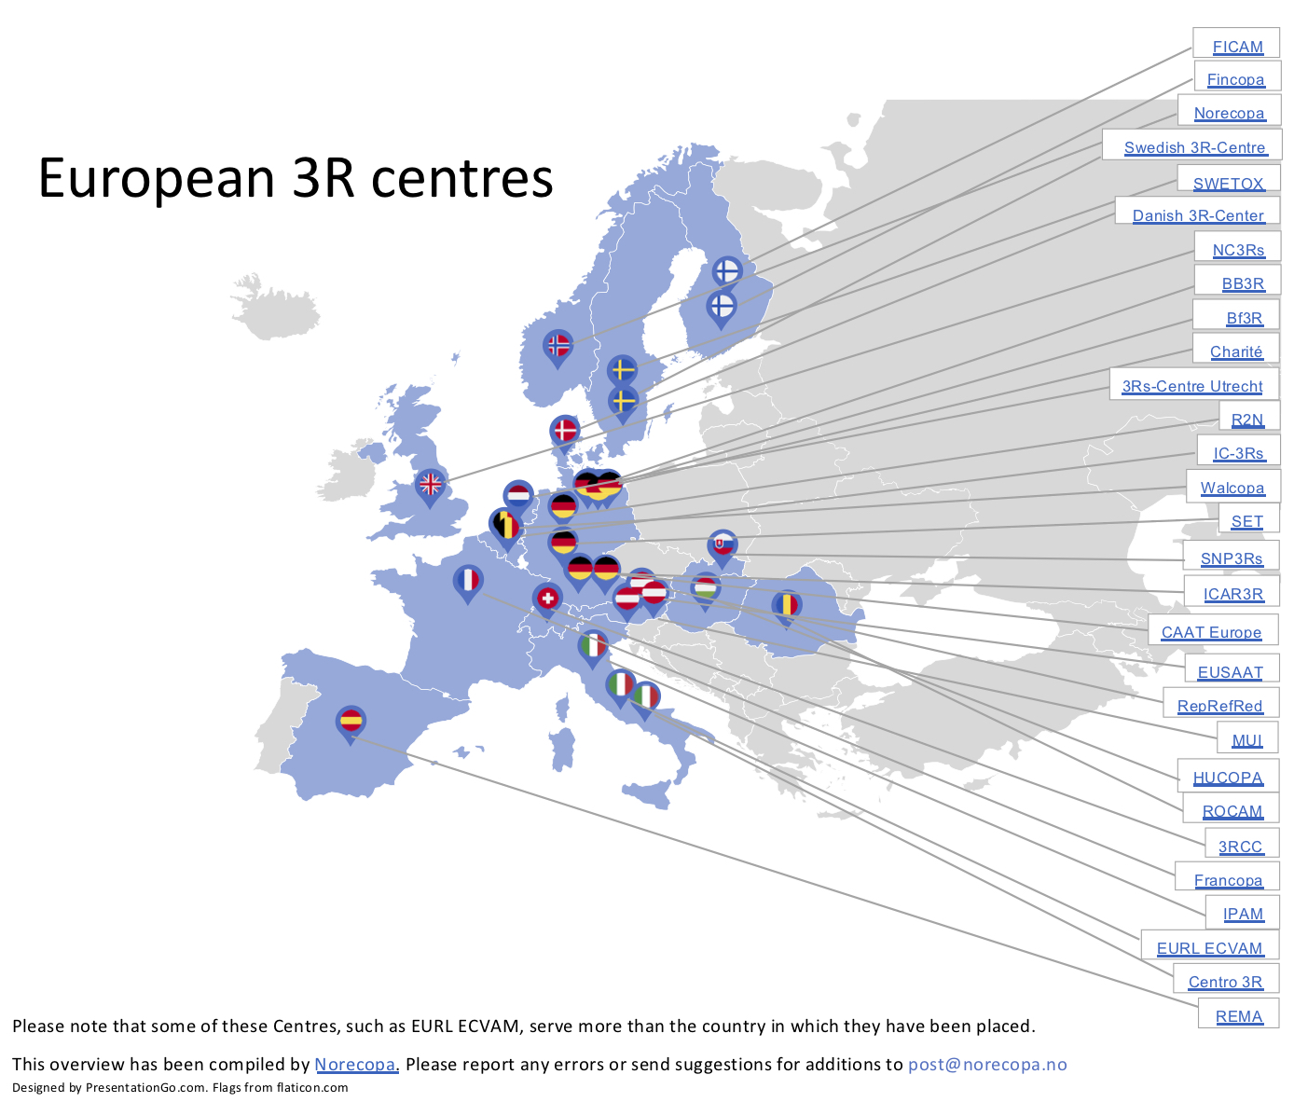
European network of 3R Centres established in 2018
- many with money earmarked for 3R research
Interactive map:
norecopa.no/3REuropeOverview
List of 3R centres:
norecopa.no/3REurope
Norecopa: PREPARE for better Science

Slide 4
norecopa.no : constructed for those involved in animal research and testing
9,900 webpages
350,000 pageviews per year
Norecopa: PREPARE for better Science

Slide 5
International consensus meetings
Harmonisation of the Care and Use of:
  Fish (2005)
  Wildlife (2008)
  Fish (2009)
  Agricultural animals (2012)
  Wildlife (2017)
https://norecopa.no/meetings
All presentations and consensus statements are on the internet: a lasting resource
Food deprivation in rodents
Toe clipping in mice
Pain relief in rodents
Fin clipping in fish
Norecopa: PREPARE for better Science

Slide 6
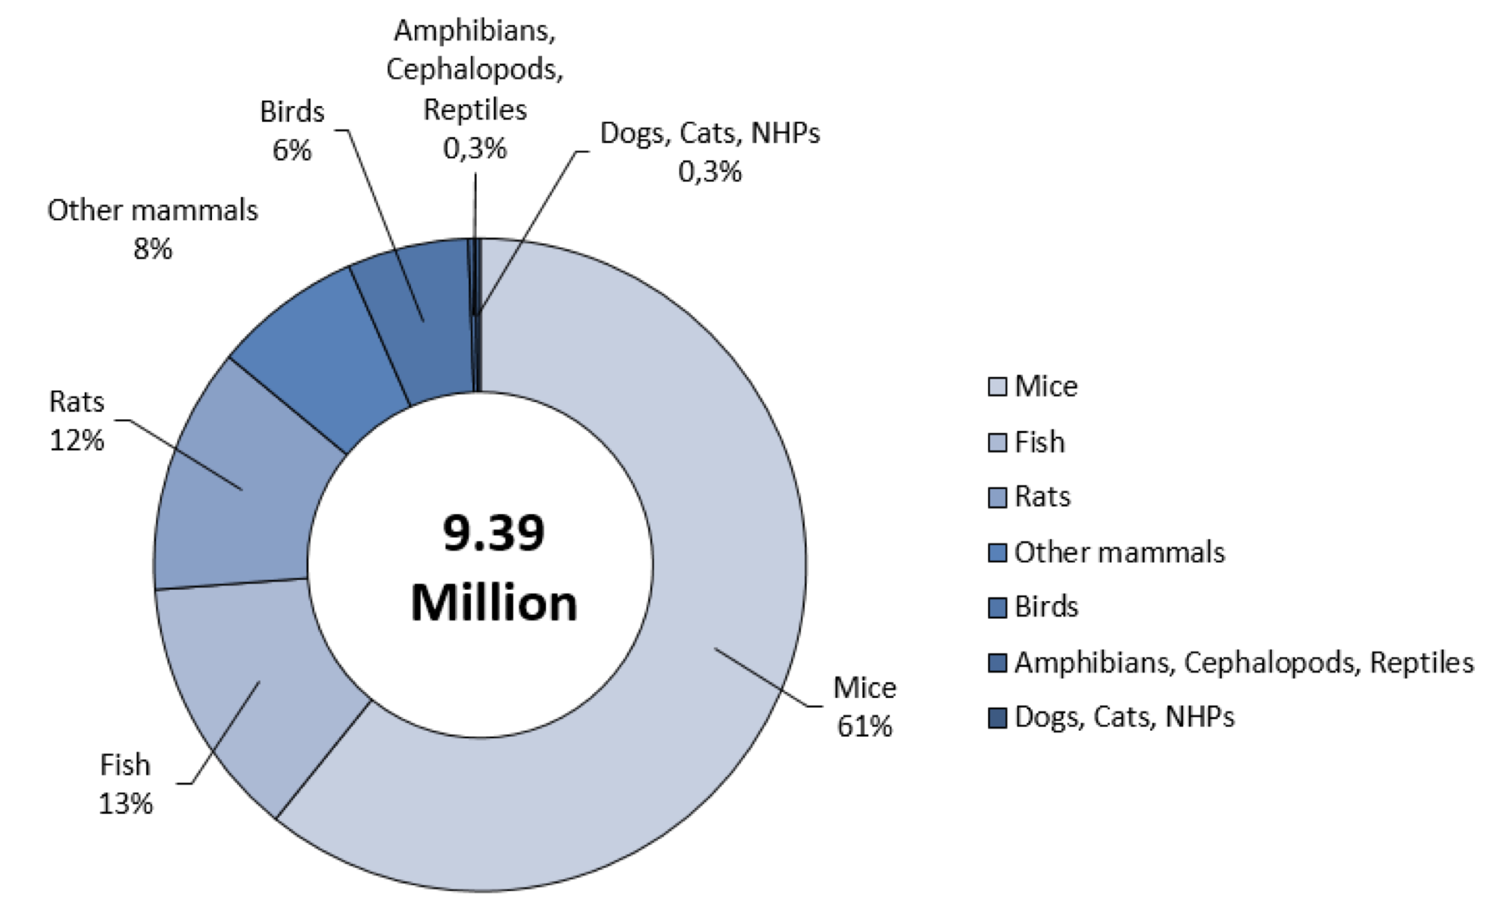
EU, 2017
Nearly 9.4 million animals used for the first time in 2017, of which 1.2 million were fish:
Zebrafish: 499,763
Other fish: 719,732
ec.europa.eu/environment/chemicals/lab_animals/reports_en.htm
Norecopa: PREPARE for better Science

Slide 7
European legislation – very little about fish
EU Directive 2010/63
Zebrafish are the only fish species which must be purpose-bred (Annex I)
Annex III (care and accommodation) contains just a short and general section on "fish", in contrast to the detail about other species, and states that ‘appropriate environmental enrichment’ does not have to be provided if ‘behavioural traits suggest none is required’
Annex IV (humane killing): "fish"
Council of Europe's Convention ETS 123, Appendix A (care and accommodation)
'Species-specific provisions for fish' are in reality just general provisions. They mention a background document produced by an expert working group (rainbow trout, Atlantic salmon, tilapiine cichlids, zebra fish, sea bass, Atlantic halibut, Atlantic cod, turbot and African catfish) but this was never published.
Norecopa: PREPARE for better Science

Slide 8
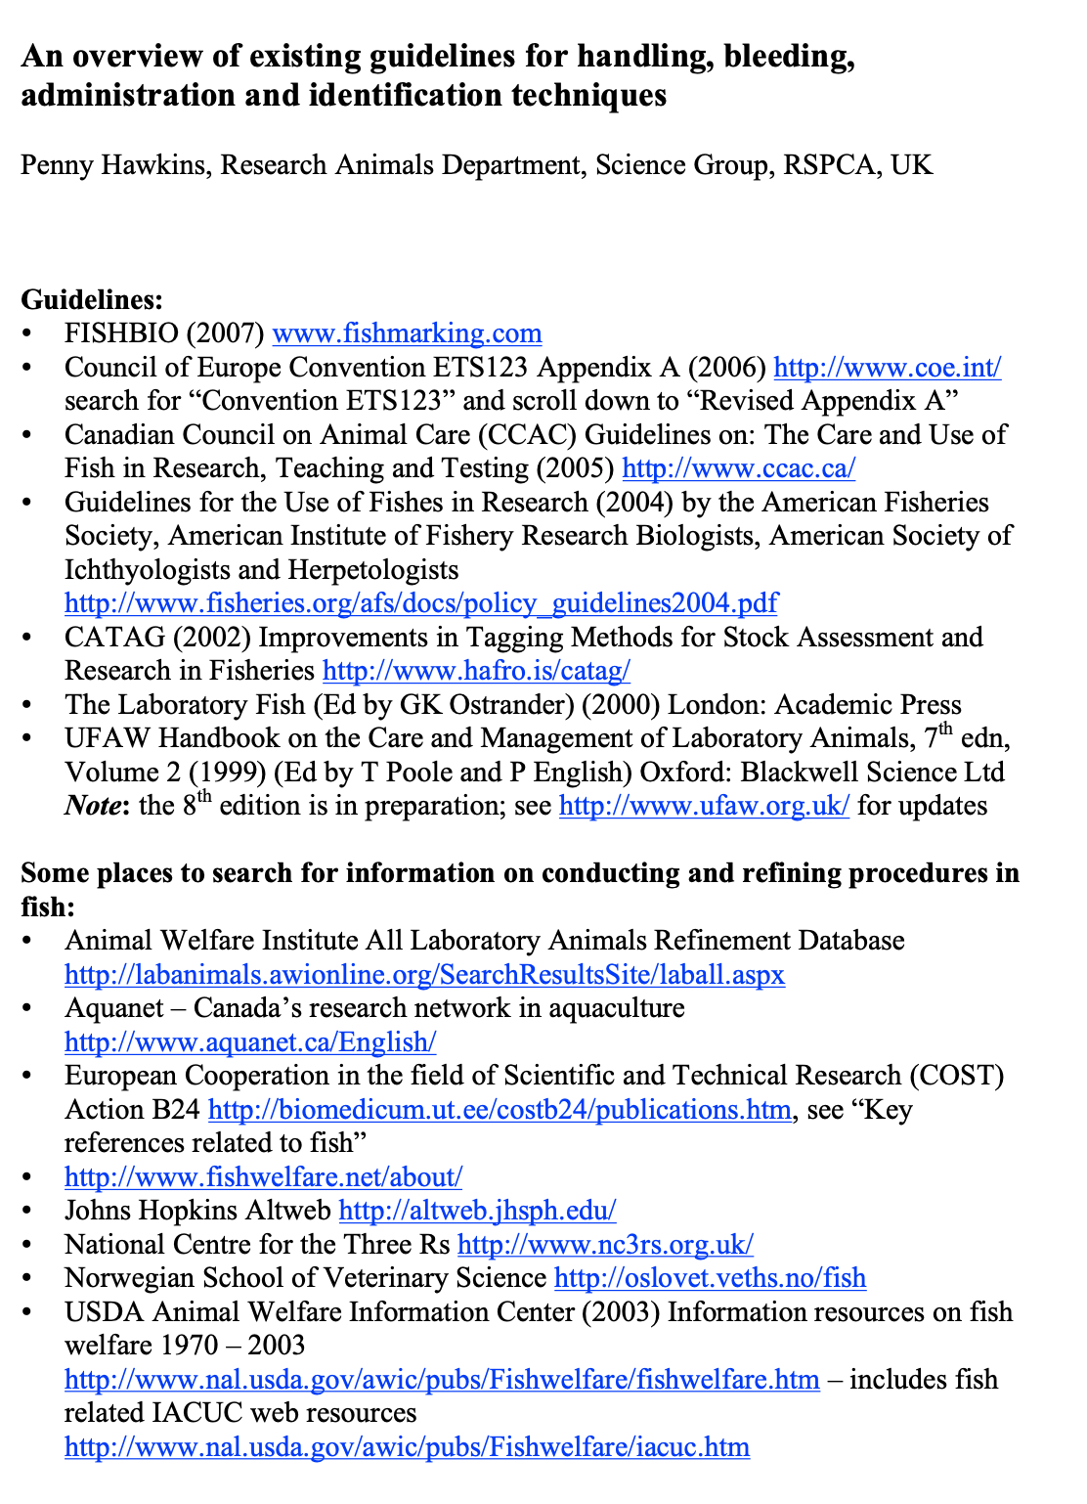
https://norecopa.no/media/6342/fish-guidelines.pdf
https://norecopa.no/search?q=guid*%20fish*&facet.limit=125&fq=db:%223r%22
Norecopa: PREPARE for better Science

Slide 9
Guidance on the severity classification of procedures
involving fish
Report from a Working Group
convened by Norecopa
http://ec.europa.eu/environment/chemicals/lab_animals/pdf/report_ewg.pdf
P Hawkins, N Dennison, G Goodman, S Hetherington,
S Llywelyn-Jones, K Ryder and AJ Smith
Laboratory Animals, 45: 219-224, 2011
norecopa.no/categories
Norecopa: PREPARE for better Science

Slide 10
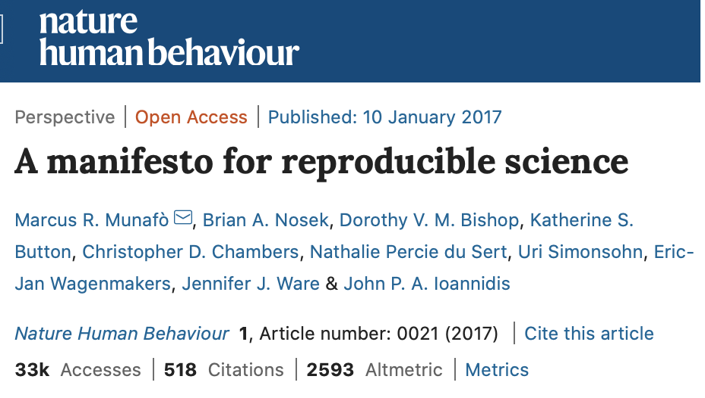
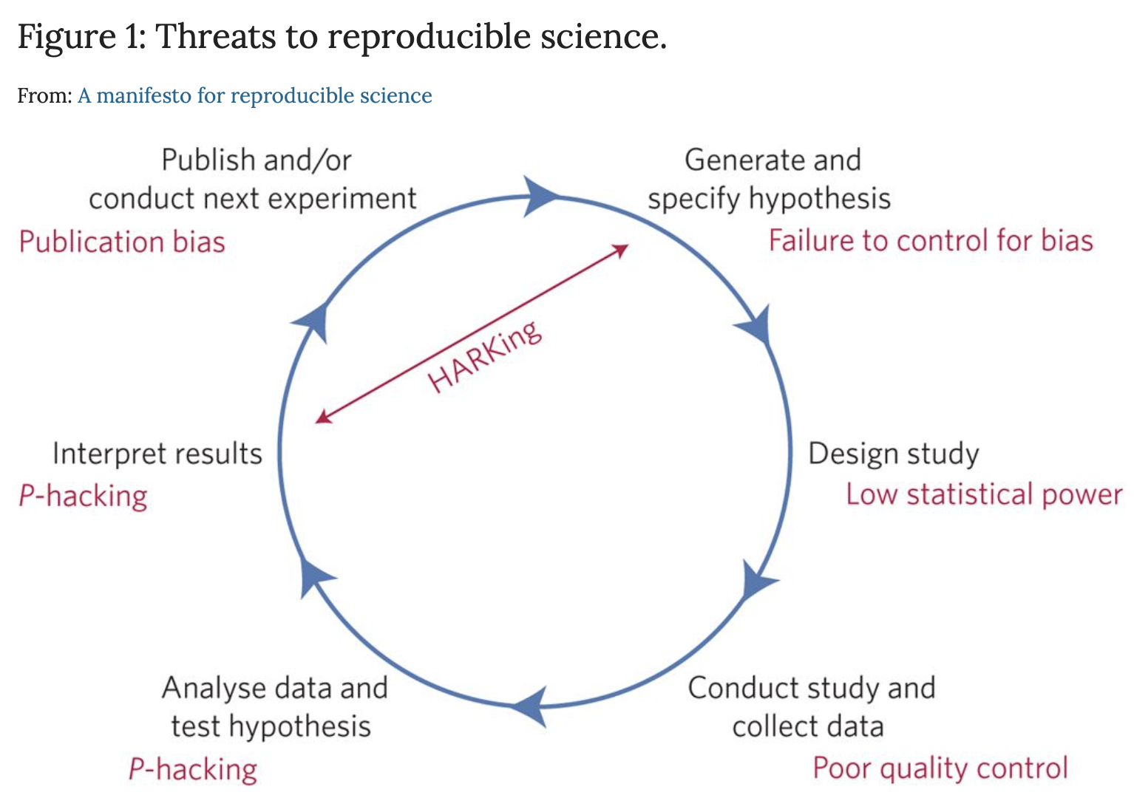
Three Rs
Norecopa: PREPARE for better Science

Slide 11
Animal-related issues include
Their genetic constitution
The possible effects of diet and subclinical infections
Additional suffering caused by, for example, transport and changes in husbandry, housing and social groups
Artefacts caused by poor handling and techniques (e.g. Injections and blood sampling)
norecopa.no/concerns
Norecopa: PREPARE for better Science

Slide 12
Some of the additional challenges related to use of fish
Acceptance of procedures with little or no anaesthesia or analgesia
Difficulty in determining when approaching death
Difficulty in assigning humane endpoints
Fish are sometimes considered as "alternatives" to experiments on mammals
Zebrafish are known to be robust animals
Norecopa: PREPARE for better Science

Slide 13
We have been trying to solve the reproducibility problem for a long time – with reporting guidelines...!
Guidelines for specification of animals and husbandry methods when reporting the results of animal experiments (GV-SOLAS, 1985)
Reporting animal use in scientific papers (Jane Smith et al.), 1997
Öbrink & Rehbinder: Animal definition: a necessity for the validity of animal experiments? Laboratory Animals, 2000
Guidelines for reporting the results of experiments on fish (2000)
ARRIVE Guidelines, 2010 (Kilkenny et al., NC3Rs) and ARRIVE v.2 2019
Gold Standard Publication Checklist, 2010 (SYRCLE)
Institute for Laboratory Animal Research, NRC, 2011
Instructions to authors, in many journals
  e.g. Nature’s Reporting Checklist
Norecopa: PREPARE for better Science

Slide 14
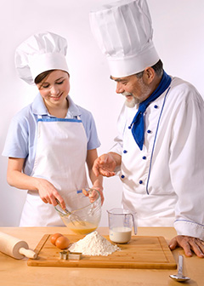
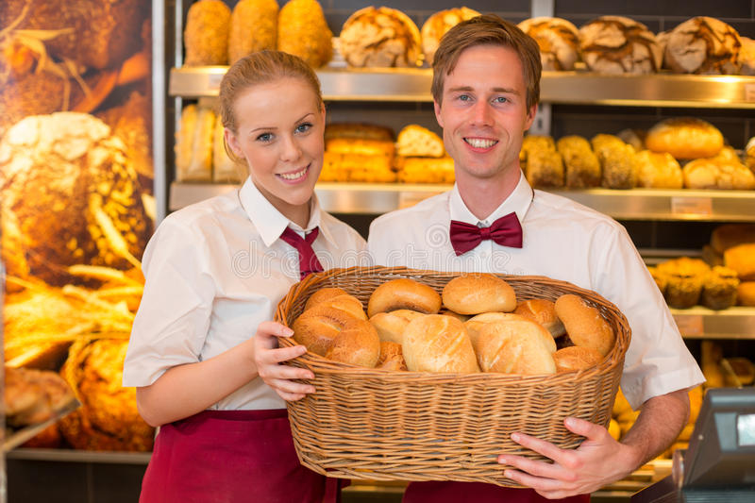
PREPARE from day 1
ARRIVE
https://www.bls.gov/ooh/images/3077.jpg
https://www.dreamstime.com
Norecopa: PREPARE for better Science

Slide 15
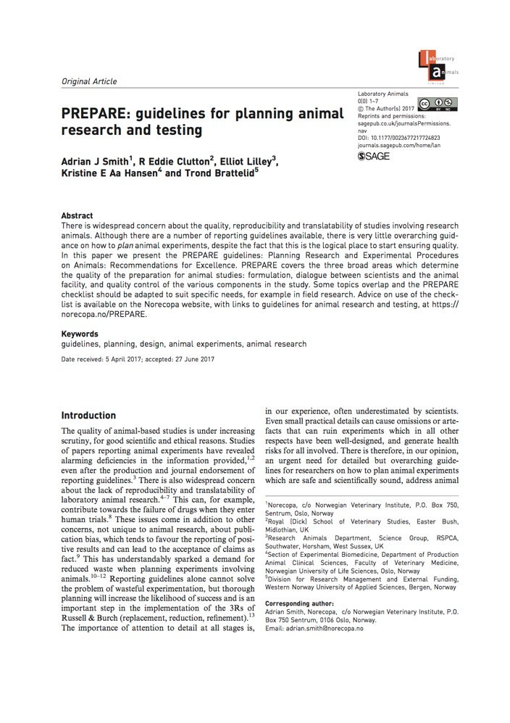
Pre-published under Open Access on 3 August 2017, sponsored by the Universities Federation for Animal Welfare (UFAW), UK
https://doi.org/10.1177/0023677217724823
Over 11,000 downloads from the
journal website so far
Also downloadable from
norecopa.no/PREPARE
Norecopa: PREPARE for better Science

Slide 16
PREPARE:
Planning Research and Experimental Procedures on Animals: Recommendations for Excellence
PREPARE covers 15 topics:
Formulation of the study
Literature searches
Legal issues
Ethical issues, harm-benefit assessment and humane endpoints
Experimental design and statistical analysis
Dialogue between scientists and the animal facility
Objectives and timescale, funding and division of labour
Facility evaluation
Education and training
Health risks, waste disposal and decontamination
Methods
Test substances and procedures
Experimental animals
Quarantine and health monitoring
Housing and husbandry
Experimental procedures
Humane killing, release, reuse or rehoming
Necropsy
Items in pink are not highlighted in ARRIVE
Norecopa: PREPARE for better Science

Slide 17
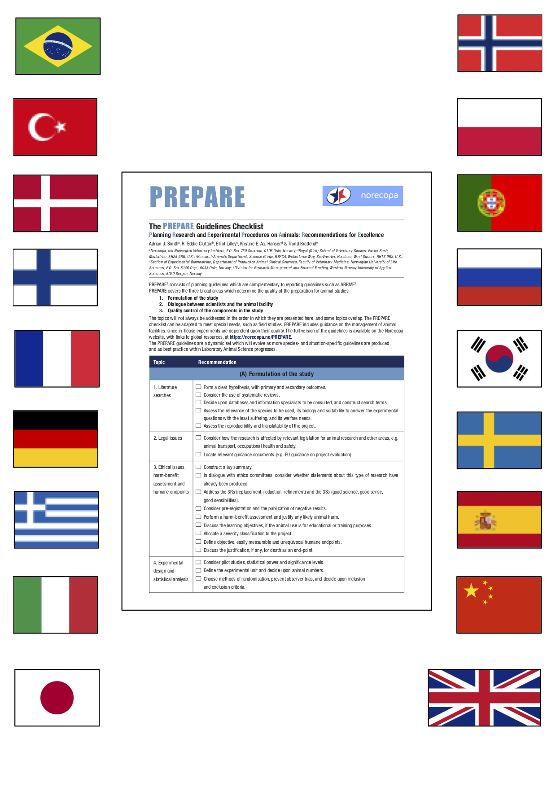

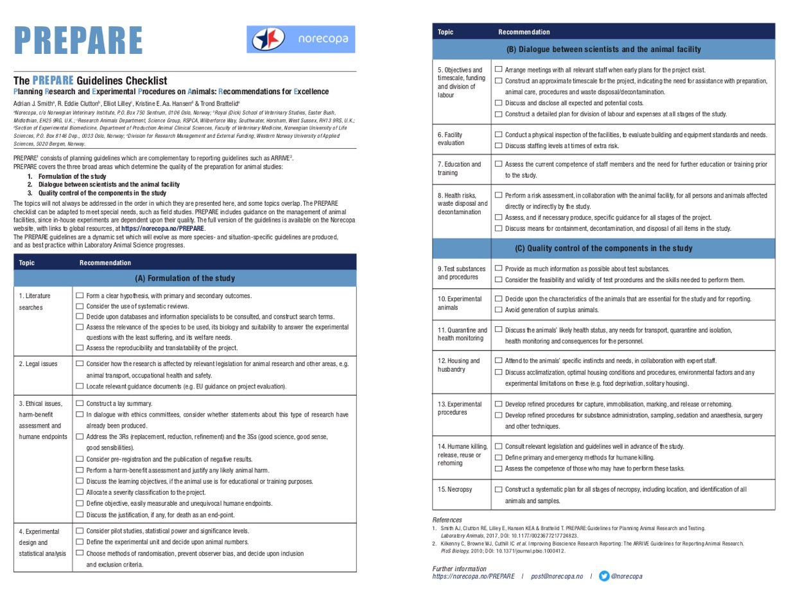

norecopa.no/PREPARE/prepare-checklist

Slide 18
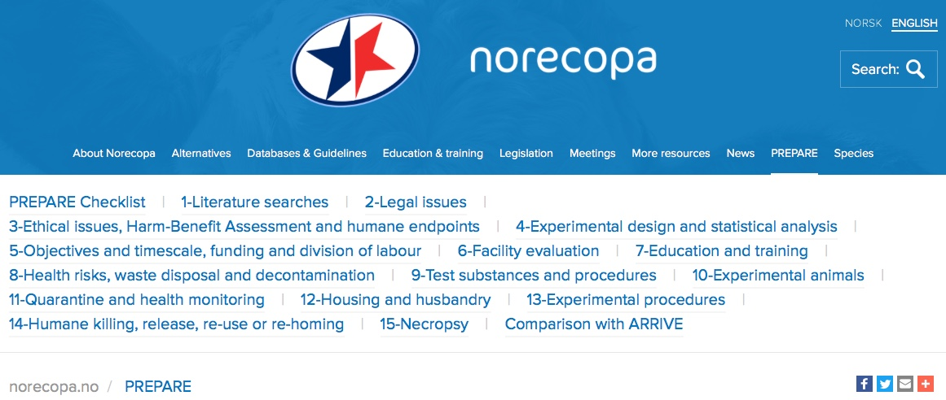
In addition to the checklist, much more information is available on:
norecopa.no/PREPARE
Norecopa: PREPARE for better Science

Slide 19
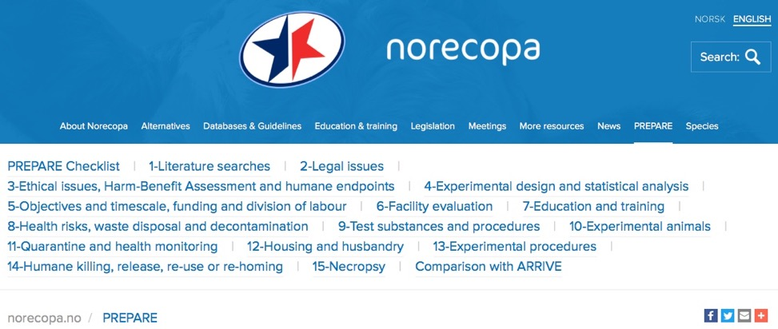
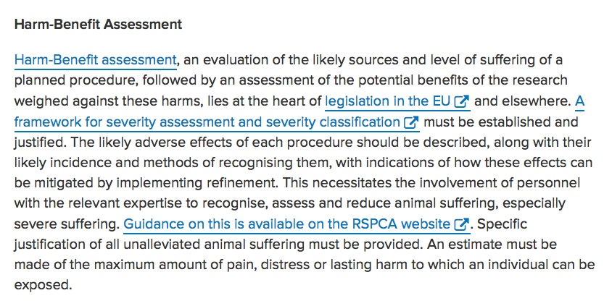
norecopa.no/PREPARE
Links to quality guidelines worldwide on e.g. blood sampling, injection volumes, housing and husbandry, analgesia, humane endpoints, experimental design
Norecopa: PREPARE for better Science

Slide 20
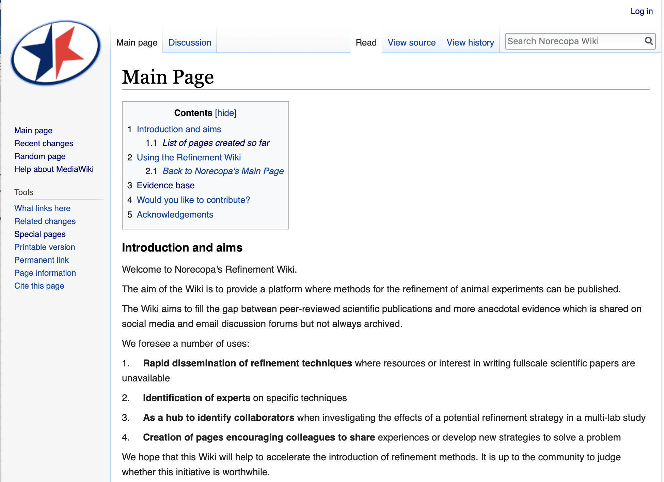
A Refinement Wiki
https://wiki.norecopa.no
Norecopa: PREPARE for better Science

Slide 21





Coming together is a beginning
Keeping together is progress
Working together is success
Edward Everett Hale
https://kmonadollaraday.files.wordpress.com/2011/03/information-silos.jpg
and colourbox.com
Norecopa: PREPARE for better Science

Slide 22











Thanks to Norecopa's main sponsors:
Standing Committee on Business Affairs, Norwegian Parliament
Norwegian Ministries of Agriculture and Fisheries
Research Council of Norway
Laboratory Animals Ltd.
Architect Finn Rahn's Legacy
Nordic Society Against Painful Experiments (NSMSD)
Norwegian Society for Animal Protection (Dyrebeskyttelsen Norge)
Norwegian Animal Protection Alliance (Dyrevernalliansen)
Novo Nordisk
Sanofi
Scottish Accreditation Board (SAB)
Stiansen Foundation
Universities Federation for Animal Welfare (UFAW)
US Department of Agriculture (USDA)
Norecopa: PREPARE for better Science

Slide 23
norecopa.no
norecopa.no/SETAC
English-language newsletters
Norecopa: PREPARE for better Science

