Slide 1


adrian.smith@norecopa.no
PREPARE for Better Science

Slide 2
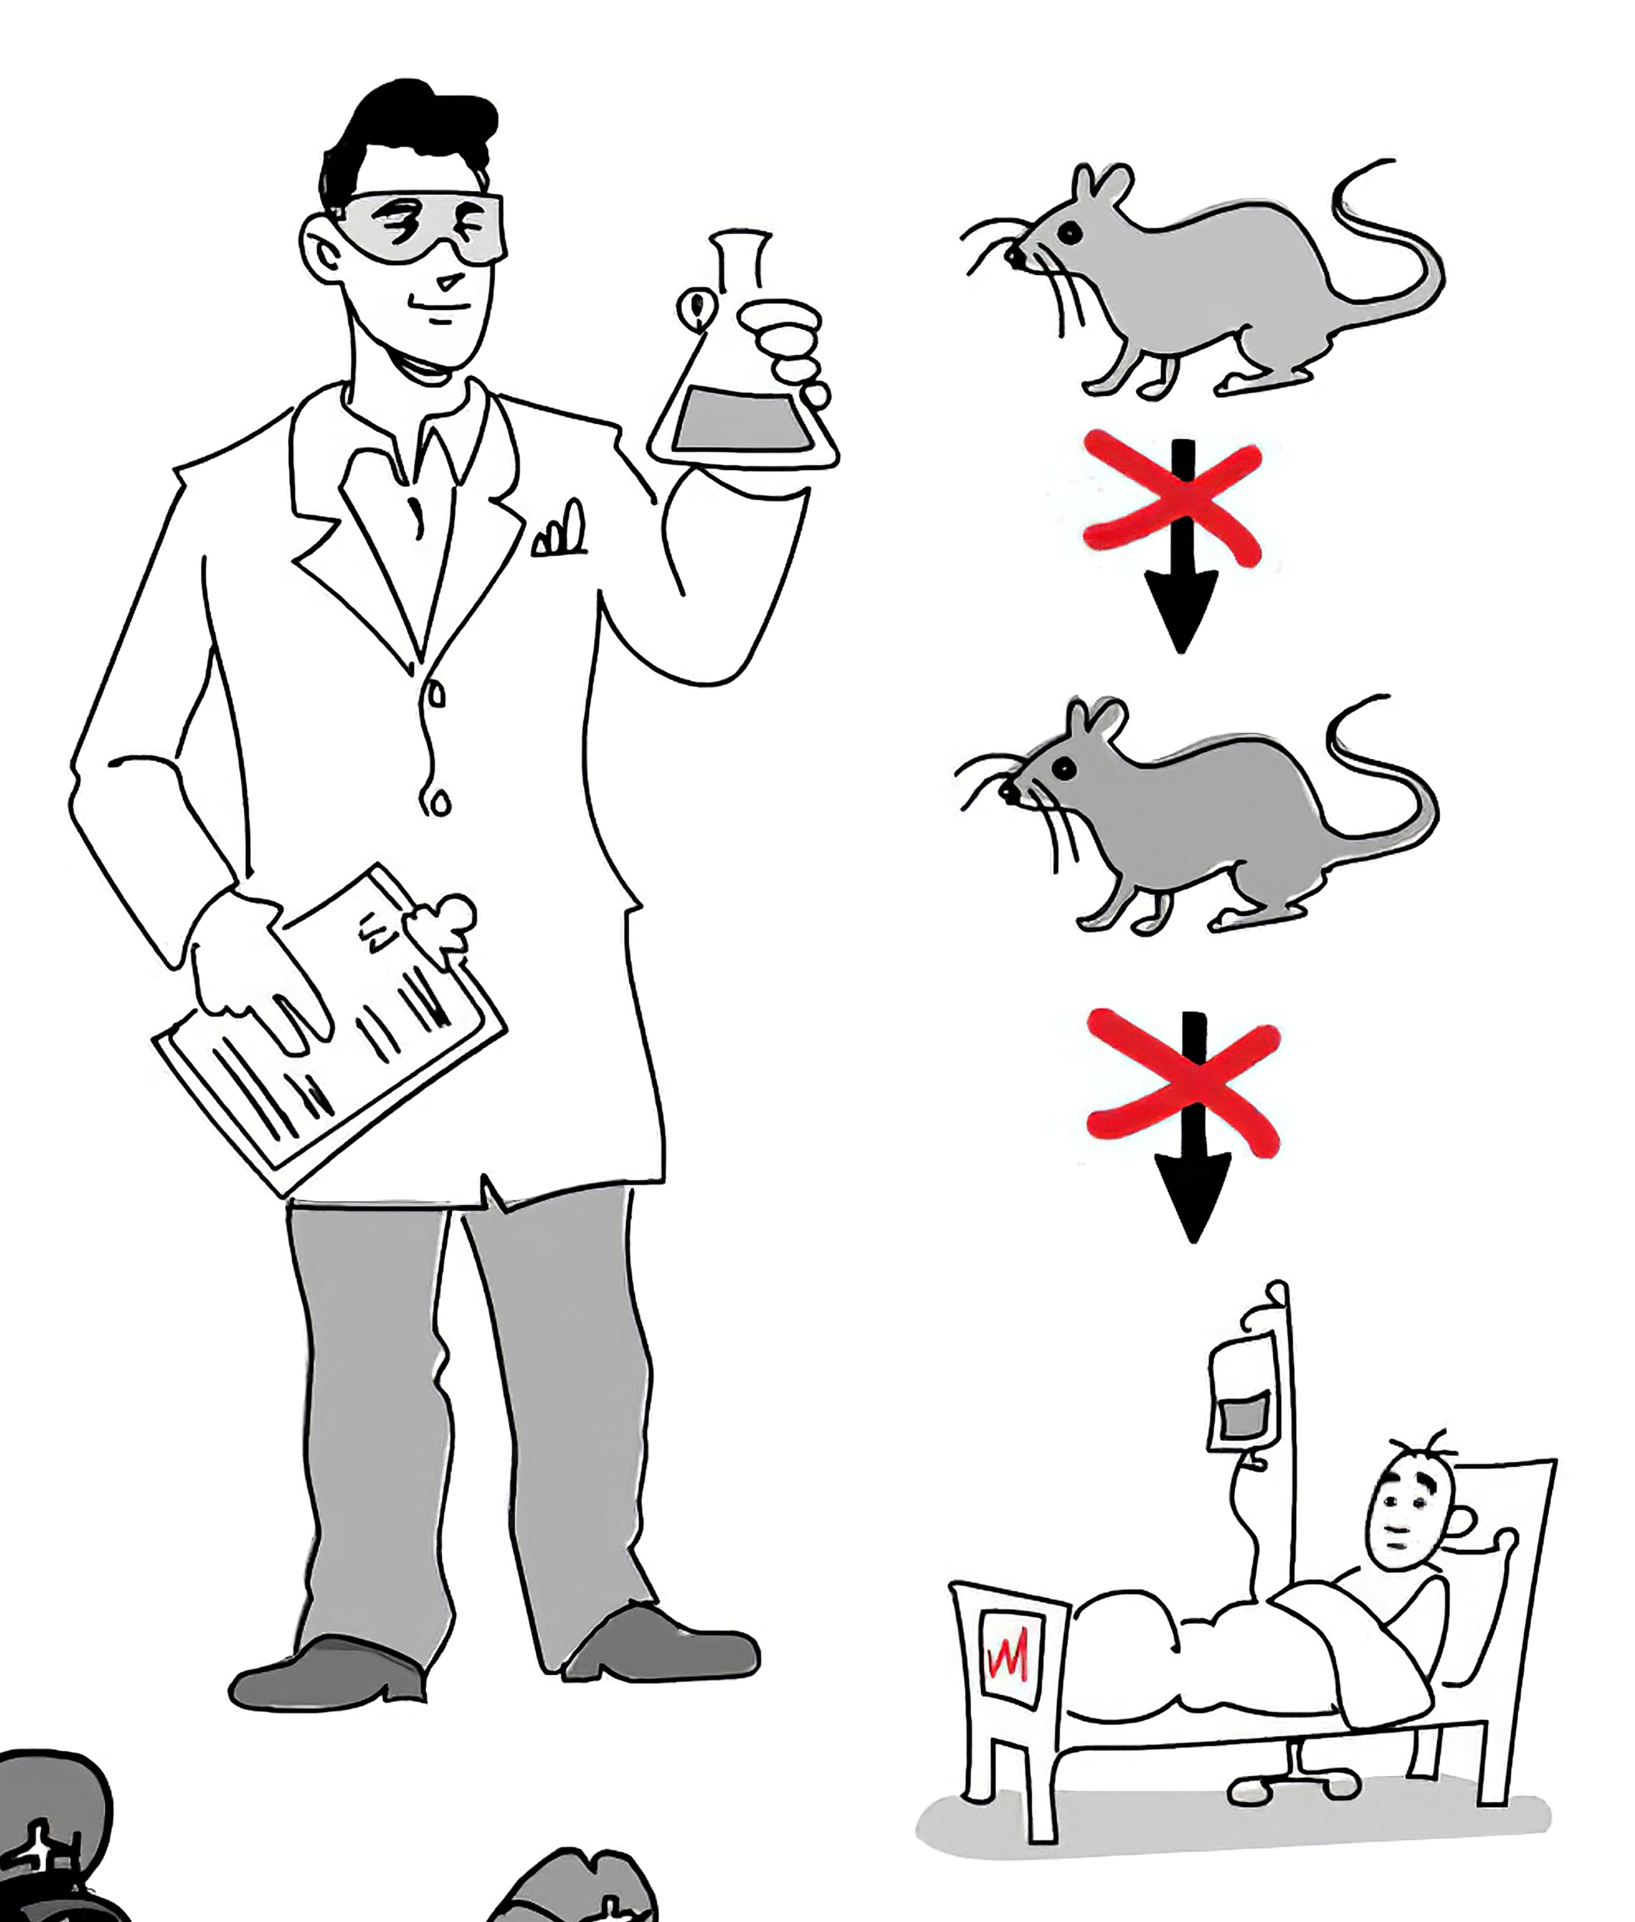
PREPARE for Better Science
Concerns:
Poor quality
- low power
- lack of randomisation & blinding
- incorrect statistical analysis
Poor replicability
Poor reproducibility
Poor translatability
norecopa.no

Slide 3
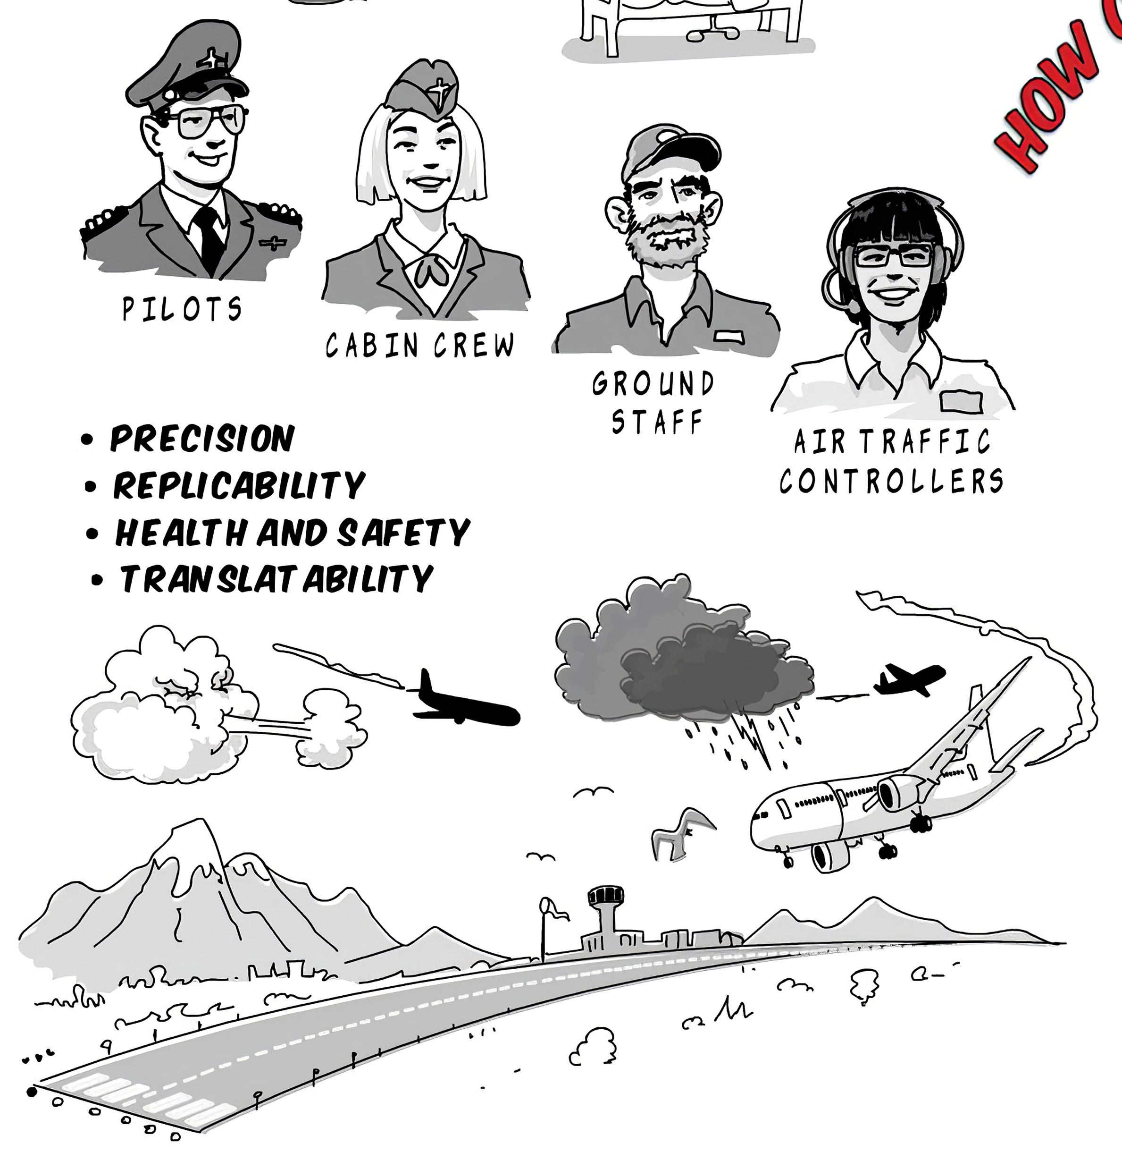
Planning guidelines: PREPARE
norecopa.no/PREPARE
PREPARE for Better Science
norecopa.no/PREPARE/film

Slide 4
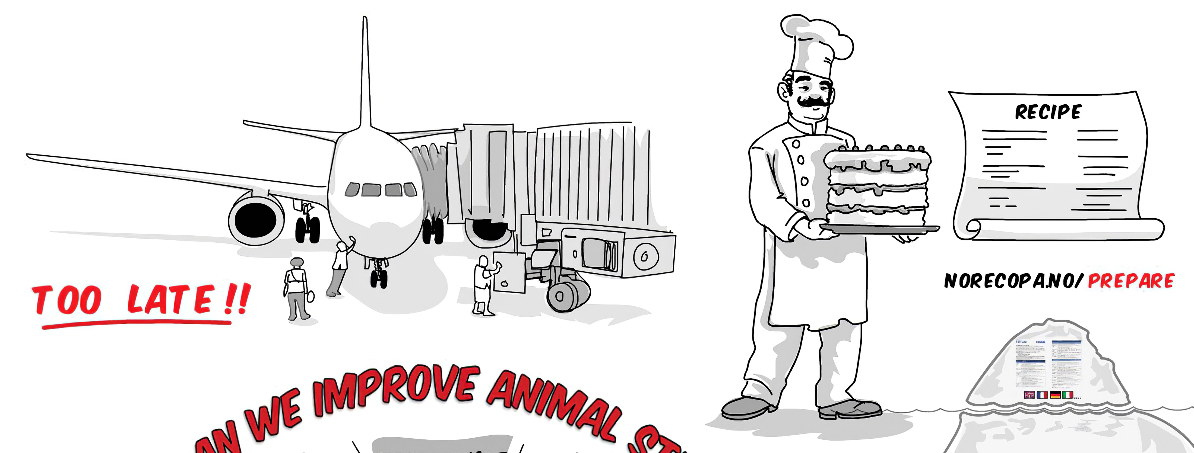
norecopa.no/PREPARE

Slide 5
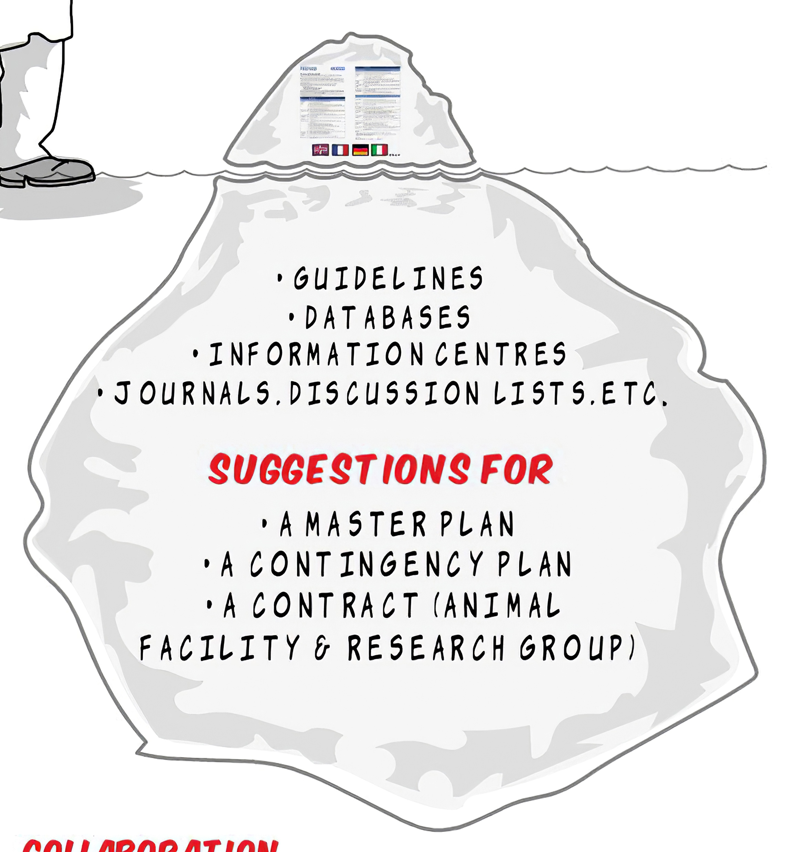
norecopa.no/PREPARE

Slide 6
Collaboration:
Animal care staff
Facility managers
Scientists
Animal welfare and ethics committees
Regulators

Slide 7

This way we can:
Reduce the risk of animals suffering
Improve our methods – do better Science
Write better funding applications
Improve manuscript quality
norecopa.no/PREPARE
Illustrations: trystad.com

