Slide 1
Empathising with animals - case studies
Animals in Science Department
@RSPCA_LabAnimal

Slide 2
Session suggestion:
Give each group one animal to consider at a time, with one table printed out per group (for feedback by a nominated person), and enough case studies for everyone to be able to read them
Use slides 3 and 4 to explain how to fill out the tables
Allow around 20 minutes for discussion, putting up slide 5 at the time to show what you will also be asking about in plenary later
Use slides 6 to 8 when asking for brief feedback on the case studies, species by species
Use slide 9 for broader discussion (very important)
Identify some actions for your AWERB (or AWB, IACUC etc), e.g. further discussion, teach-ins or workshops for all on animal experiences, how to factor more empathy in to project application reviews …

Slide 3
Small group discussion - three scenarios
Mouse, dog, zebrafish
Column 1 - what is done to the animal
Interactions and events may be normalised to humans, but very significant to animals, so we need to think about …
Column 2 - how might the animal feel?
‘Critical anthropomorphism’; begin with ‘how would I feel’ then apply your animal welfare knowledge
Column 3 - how could negative feelings be alleviated?

Slide 4
Example

Slide 5
Feedback - we will be asking you …
Key points from your discussions about the mouse, dog and zebrafish, also:
Do you find some species easier to empathise with than others? Why?
Do you think your AWERB pays enough attention to understanding animals’ experiences?
Whose role on the AWERB do you think it is to encourage this?
Has this made you reflect on your contributions to your AWERB, within project review or more widely? Do you feel confident about this, and/or how could you gain support?
… over to you!

Slide 6
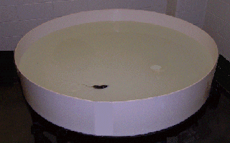
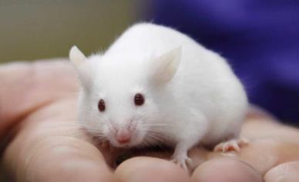
The mouse
Used to test candidate dementia drug
Repeated intraperitoneal injections over 10 weeks
EEG recordings from implanted device
Behavioural tests including Morris water maze
watermaze.org

Slide 7
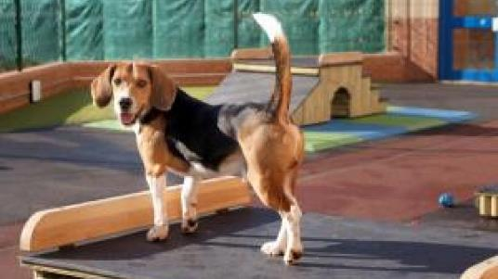
The dog
Used in safety pharmacology tests
Implanted ECG transmitter to enable monitoring of heart rate and function
Trained to accept oral gavage and standing still in sling
Housed in establishment for several years
nc3rs.org.uk

Slide 8
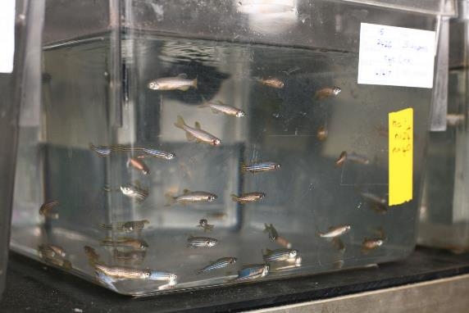
The zebrafish
Used in a study of myocardial infarct (heart attack)
Housed in shoals in bare tanks, fish fed a diet of flake food and live brine shrimp
Heart wall damaged with a supercooled probe, under general anaesthetic
Repeated measurements taken of electrical activity in the heart using a microelectrode under anaesthetic
understandinganimalresearch.org.uk

Slide 9
Do you find some species easier to empathise with than others? Why?
Do you think your AWERB pays enough attention to understanding animals’ experiences?
Whose role on the AWERB do you think it is to encourage this?
Has this made you reflect on your contributions to your AWERB, within project review or more widely? Do you feel confident about this, and/or how could you gain support?

